Slide 1
Medical Oxygen Training Program
Project BOXER Training and Capacity Building
This document was developed by Build Health International for the Global Fund’s Project BOXER.

Slide 2
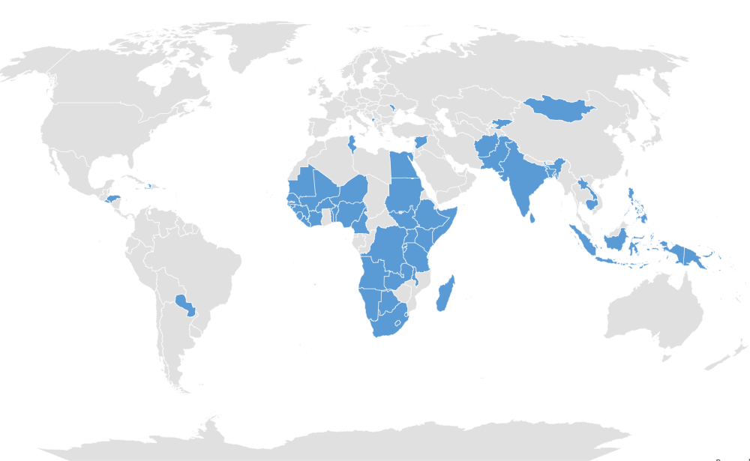
Project BOXER: TA for C19RM Bulk O2 Investments
Project Scope/Objective: To provide technical assistance (TA) that will support the implementation, monitoring and oversight of Pressure Swing Adsorption (PSA) plants and relevant Global Fund oxygen investments to ensure sustainability and maximized impact of increased global oxygen capacity.
TA Provider: Build Health International (BHI)
Who is BHI?
A design-and-build nonprofit dedicated to delivering dignified, high-quality healthcare solutions in low-resource settings throughout the world.
Project BOXER is providing technical assistance to 60 out of 60 countries supporting PSA plants via C19RM. (May 2025)

Slide 3
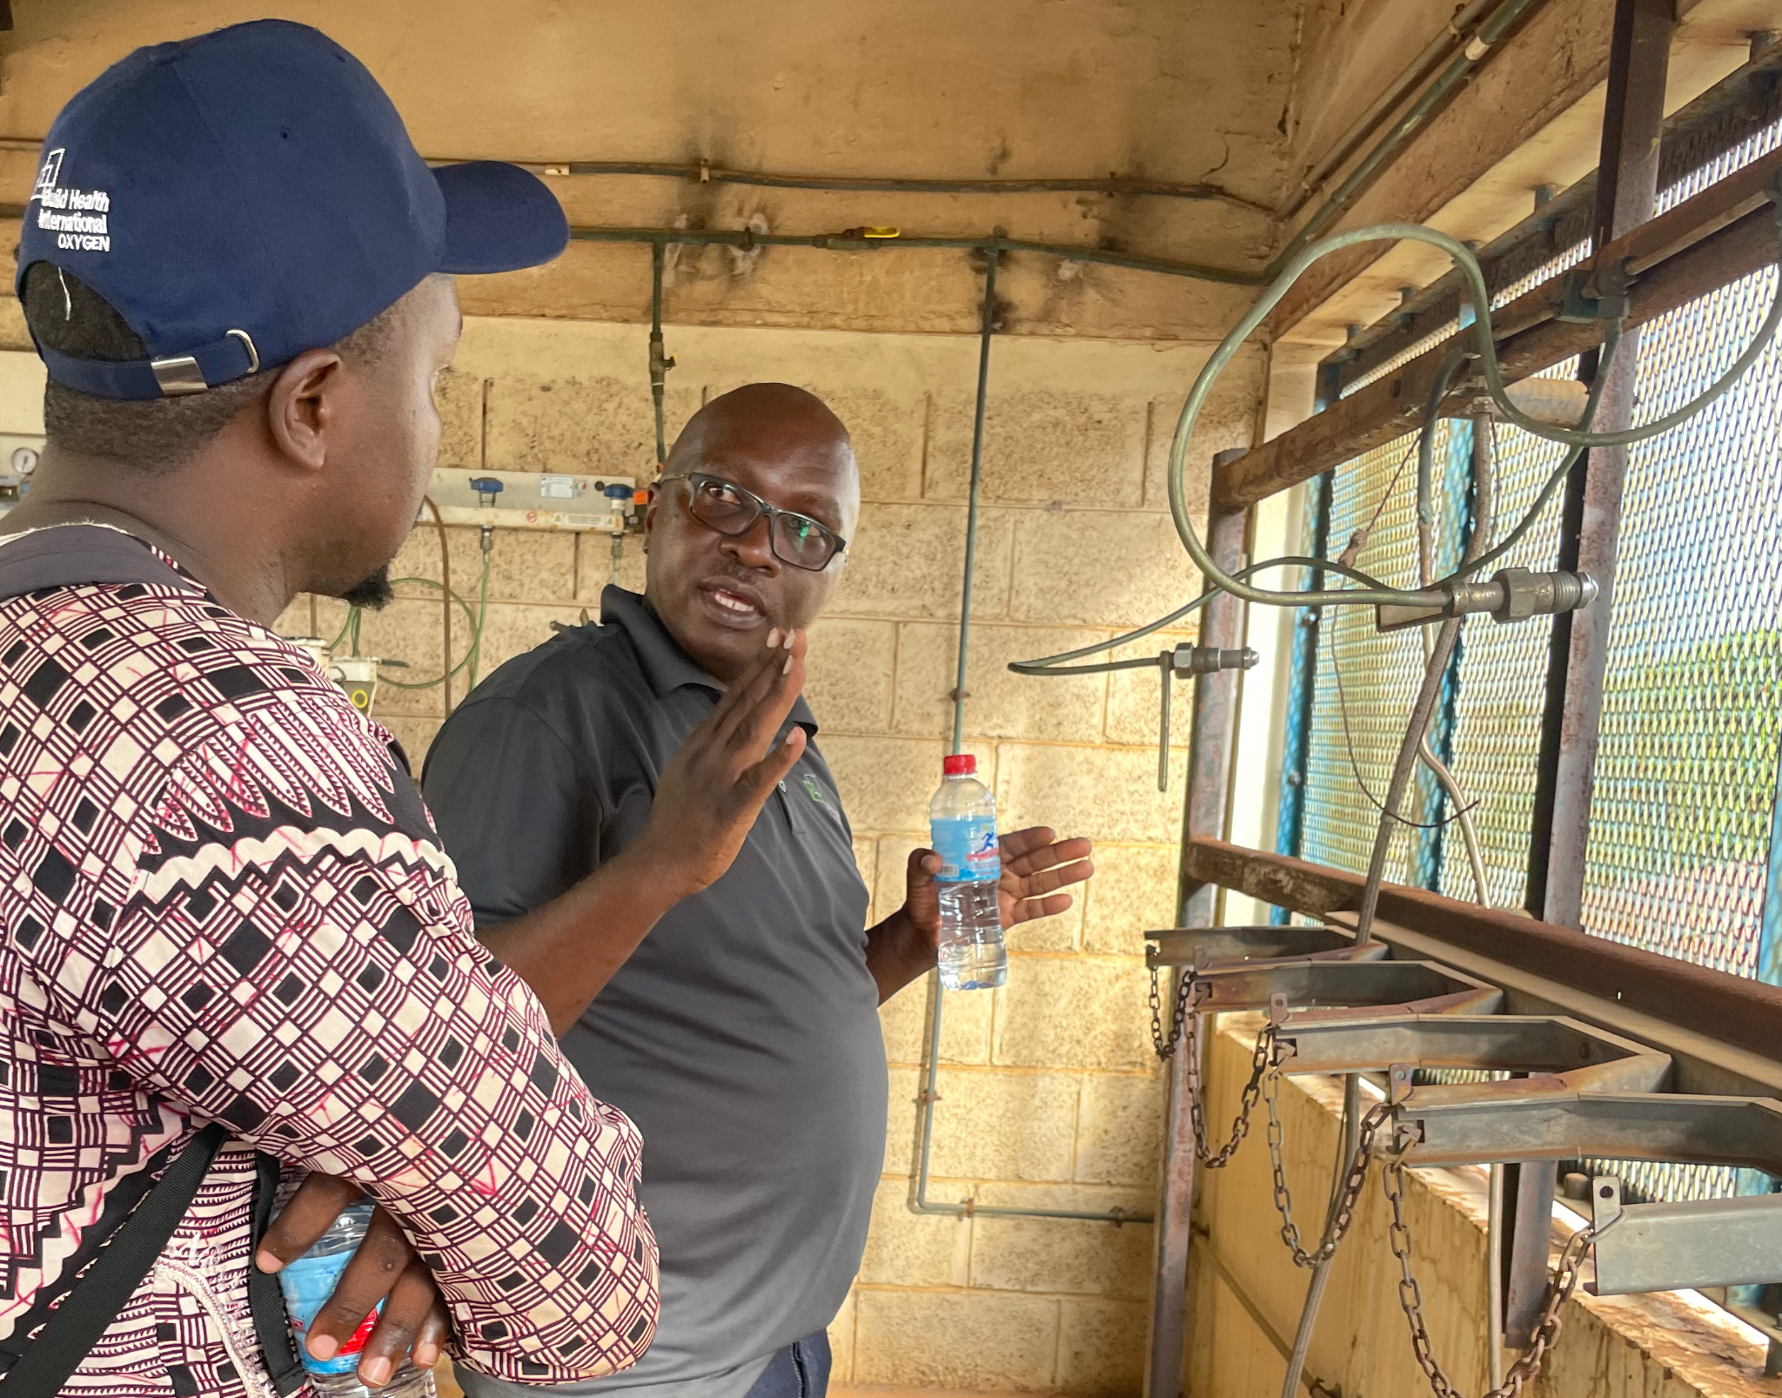
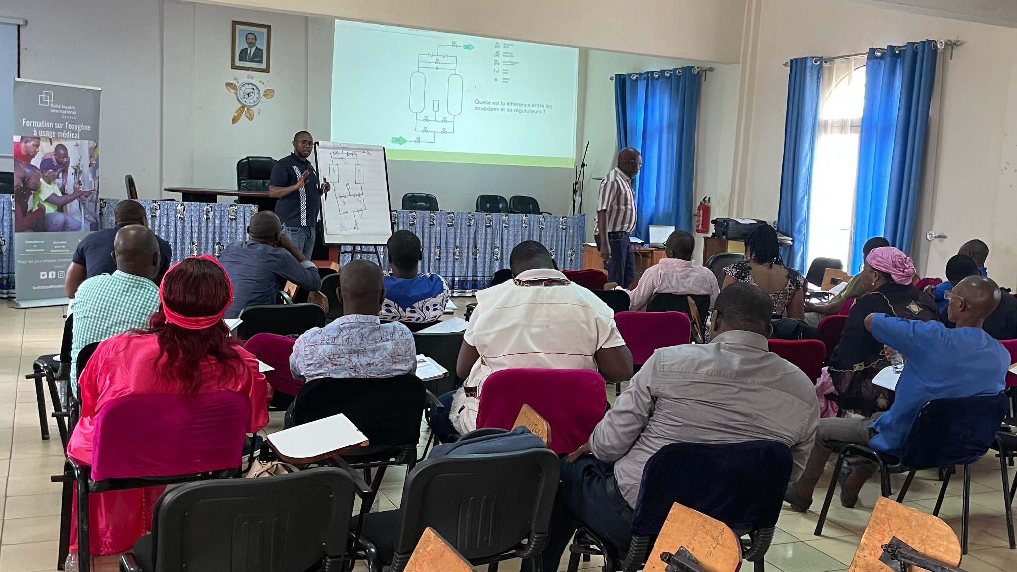
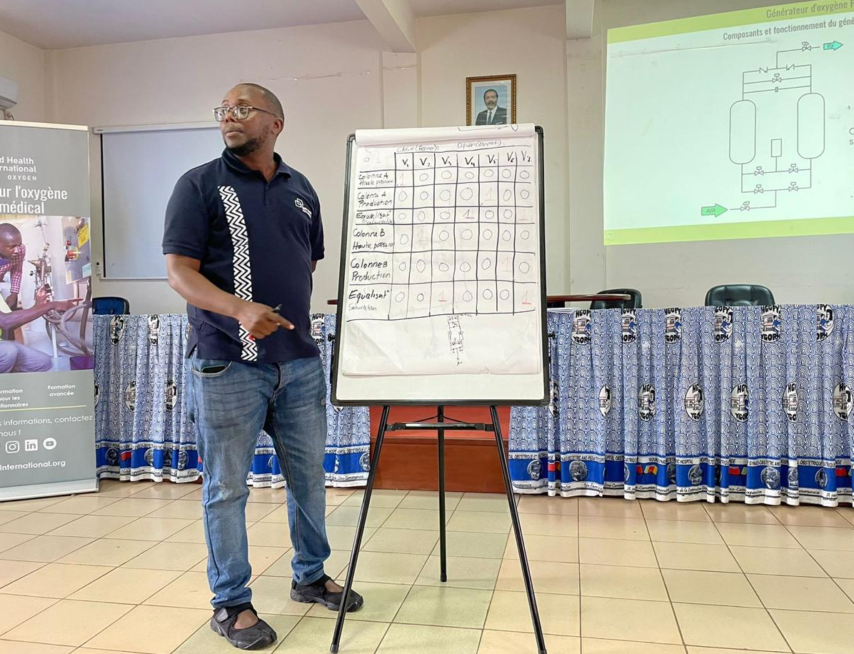
Information Session Outline
Why Project BOXER Training?
Overview of Project BOXER Training
Ongoing Support
Training Process
Questions and Answers

Slide 4



Why Training?
The Situation
Observed Consequences
Our Recommendation
In most health systems receiving PSA Plants, biomedical technicians lack adequate knowledge of how to maintain and safely operate PSA plants or oxygen delivery systems.
Senior leadership is often unprepared to successfully and sustainably integrate PSA plants into health systems and hospitals.
PSA plants are challenging to maintain and include components that are not found in other hospital equipment.
Critical biomedical equipment maintenance management systems are historically overlooked.
Staff could not operate or maintain the plants.
Short useful life of new PSA plants. Frequent breakdown and unnecessary damage.
Lack of spare parts meant broken plants could not be repaired.
Oxygen safety was not adequately addressed. Serious accidents.
Frequent interruptions in the oxygen supply.
Significant losses in investment.
Reliance on expensive commercial O2 sources when PSA plants broke down.
Dependency on service contracts.
Inability to perform maintenance after service contract ends.
Training and capacity building
Health systems with internal knowledge of PSA plants maintain oxygen access because they are far better positioned to:
Address PSA plant underperformance
Manage their service contracts
Continue PSA plant maintenance after service contract ends

Slide 5
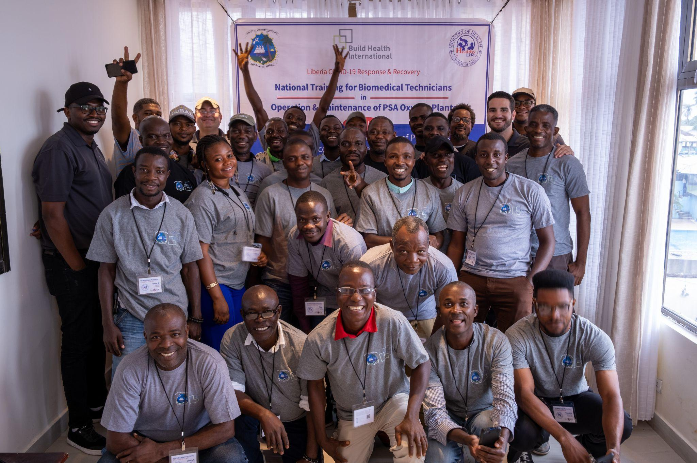
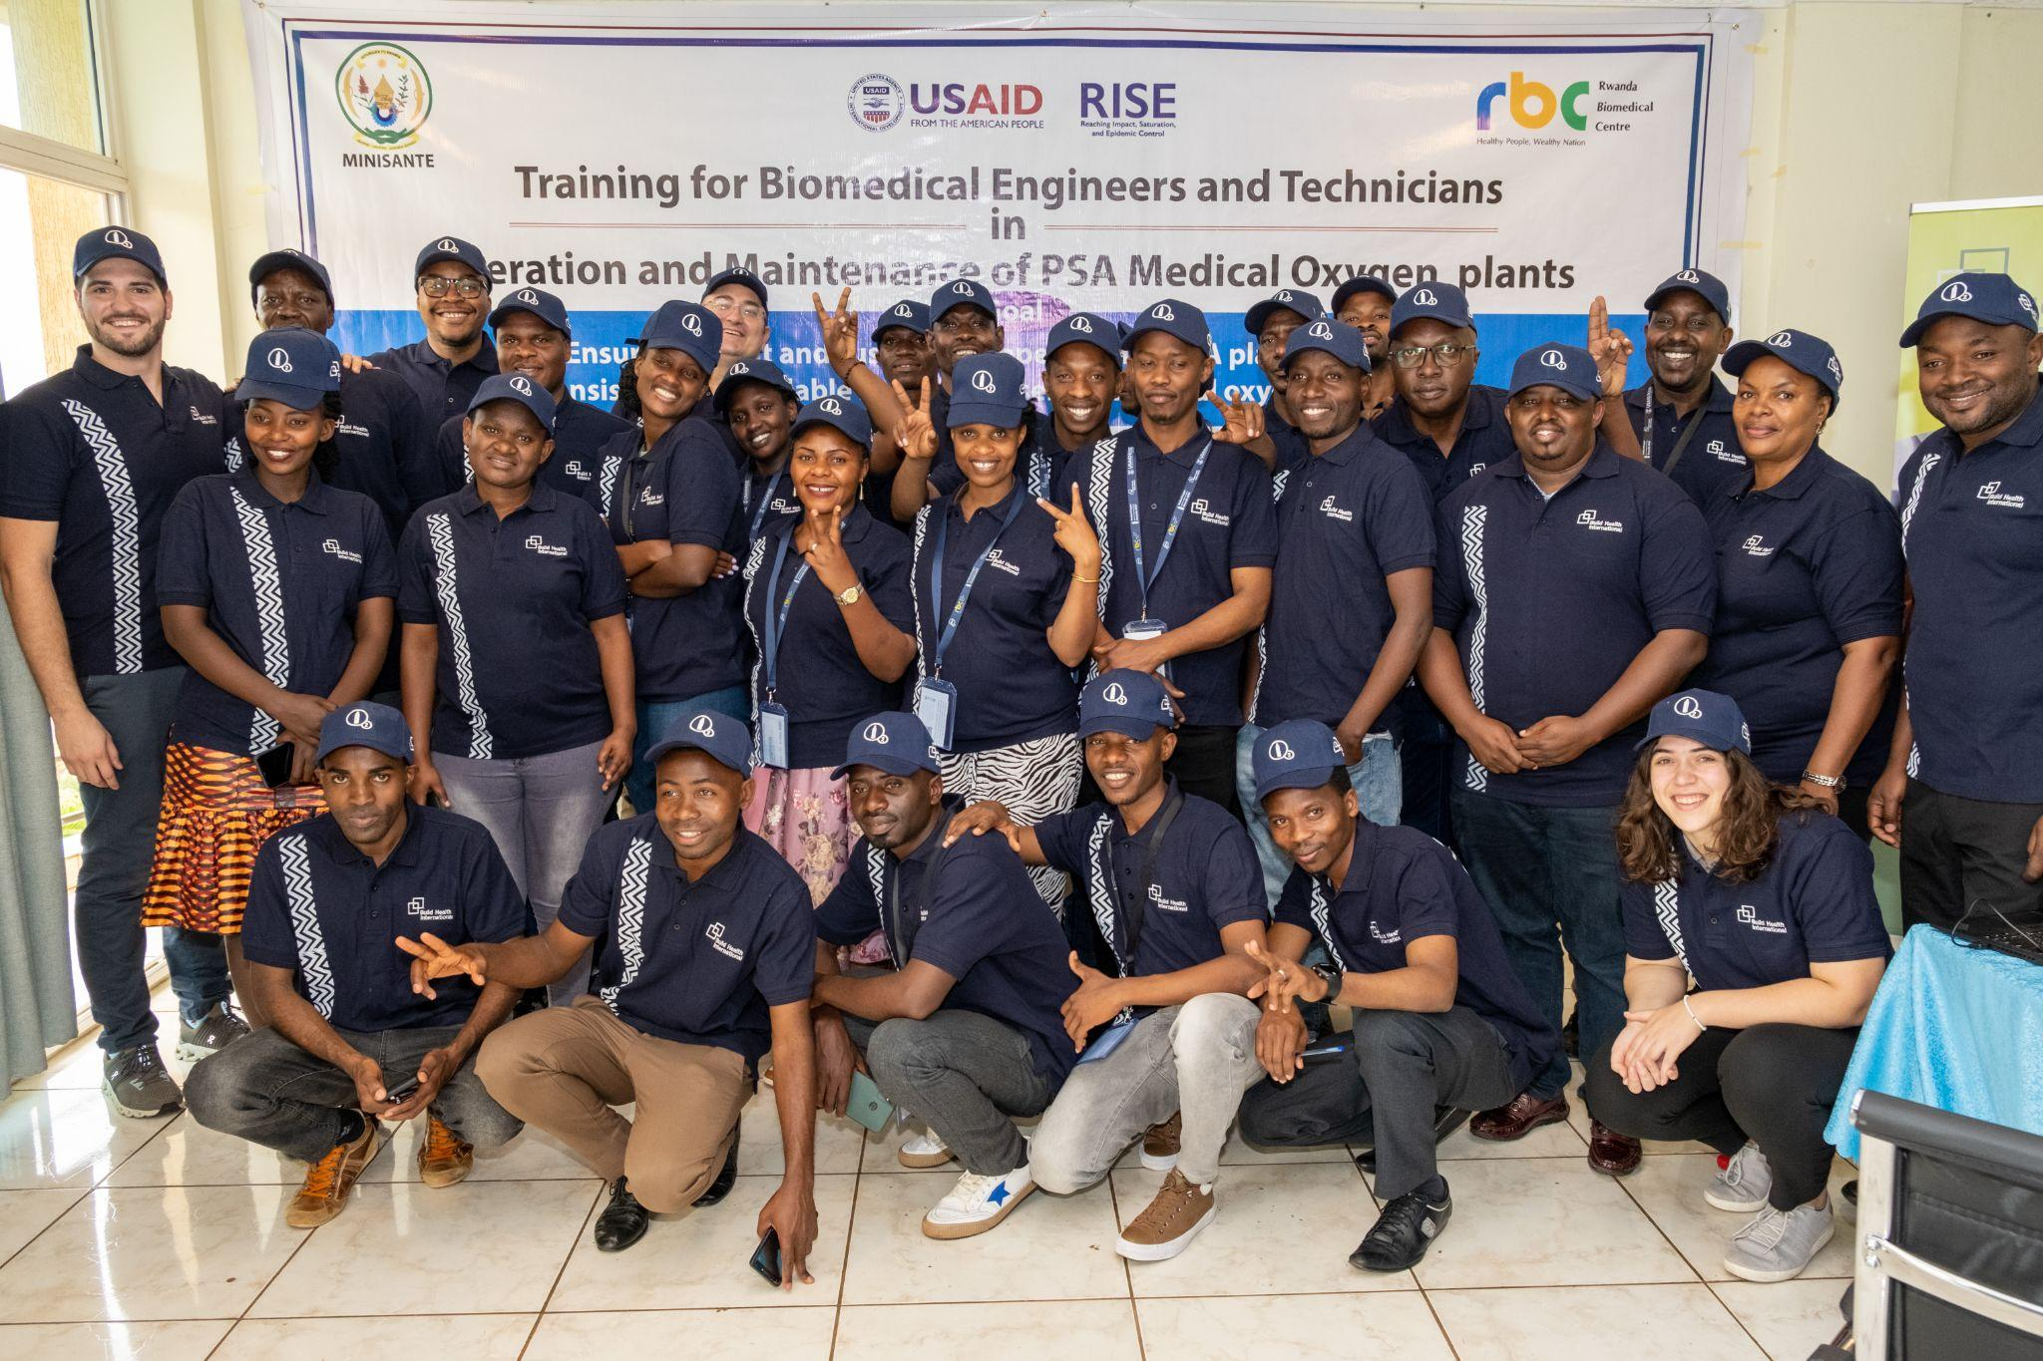
BHI’s Medical Oxygen Program
BHI developed a PSA plant and oxygen delivery training curriculum in early 2022. To date, BHI has trained over 1,000 biomedical engineers, technicians, and facilities maintenance staff.
BHI has delivered training in Burkina Faso, Cameroon, Guinea, Lesotho, Liberia, Mali, Nepal, Rwanda, Sierra Leone, and Sudan.
Three types of oxygen training are available to C19RM recipients as a part of Project BOXER:
Management Training
Maintenance Training
Training of Trainers (Advanced Maintenance)
All trainings are available in English and French!
*Other languages may be possible upon request.
Notes:
Dates

Slide 6
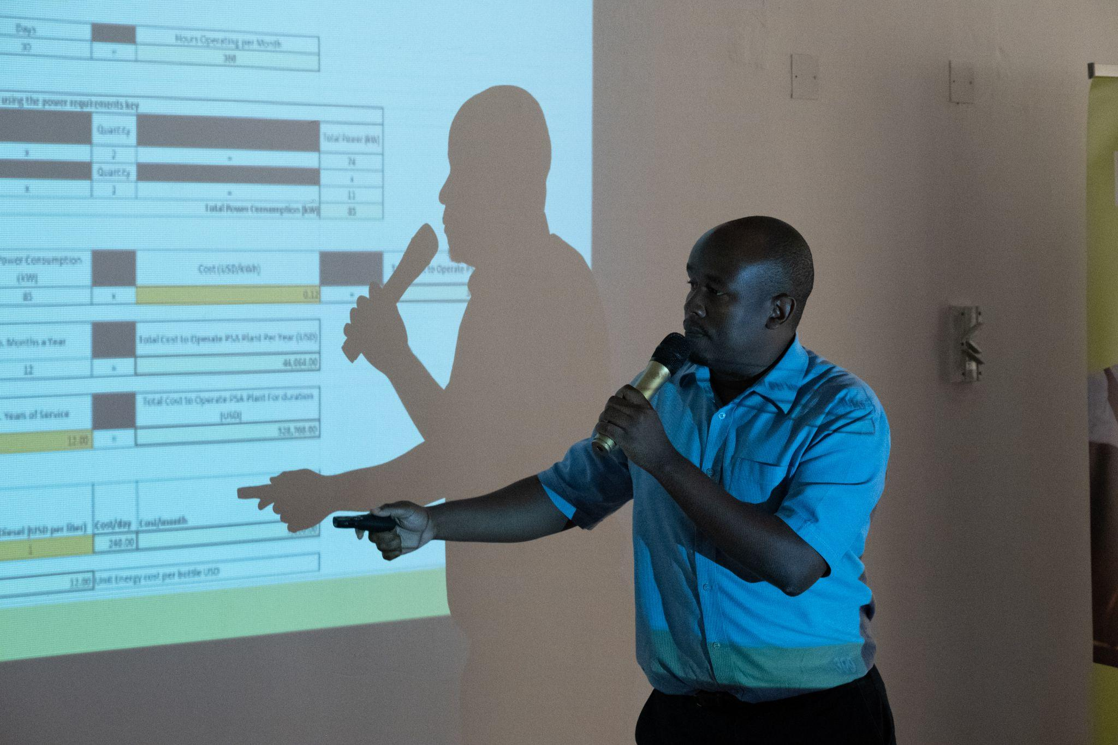
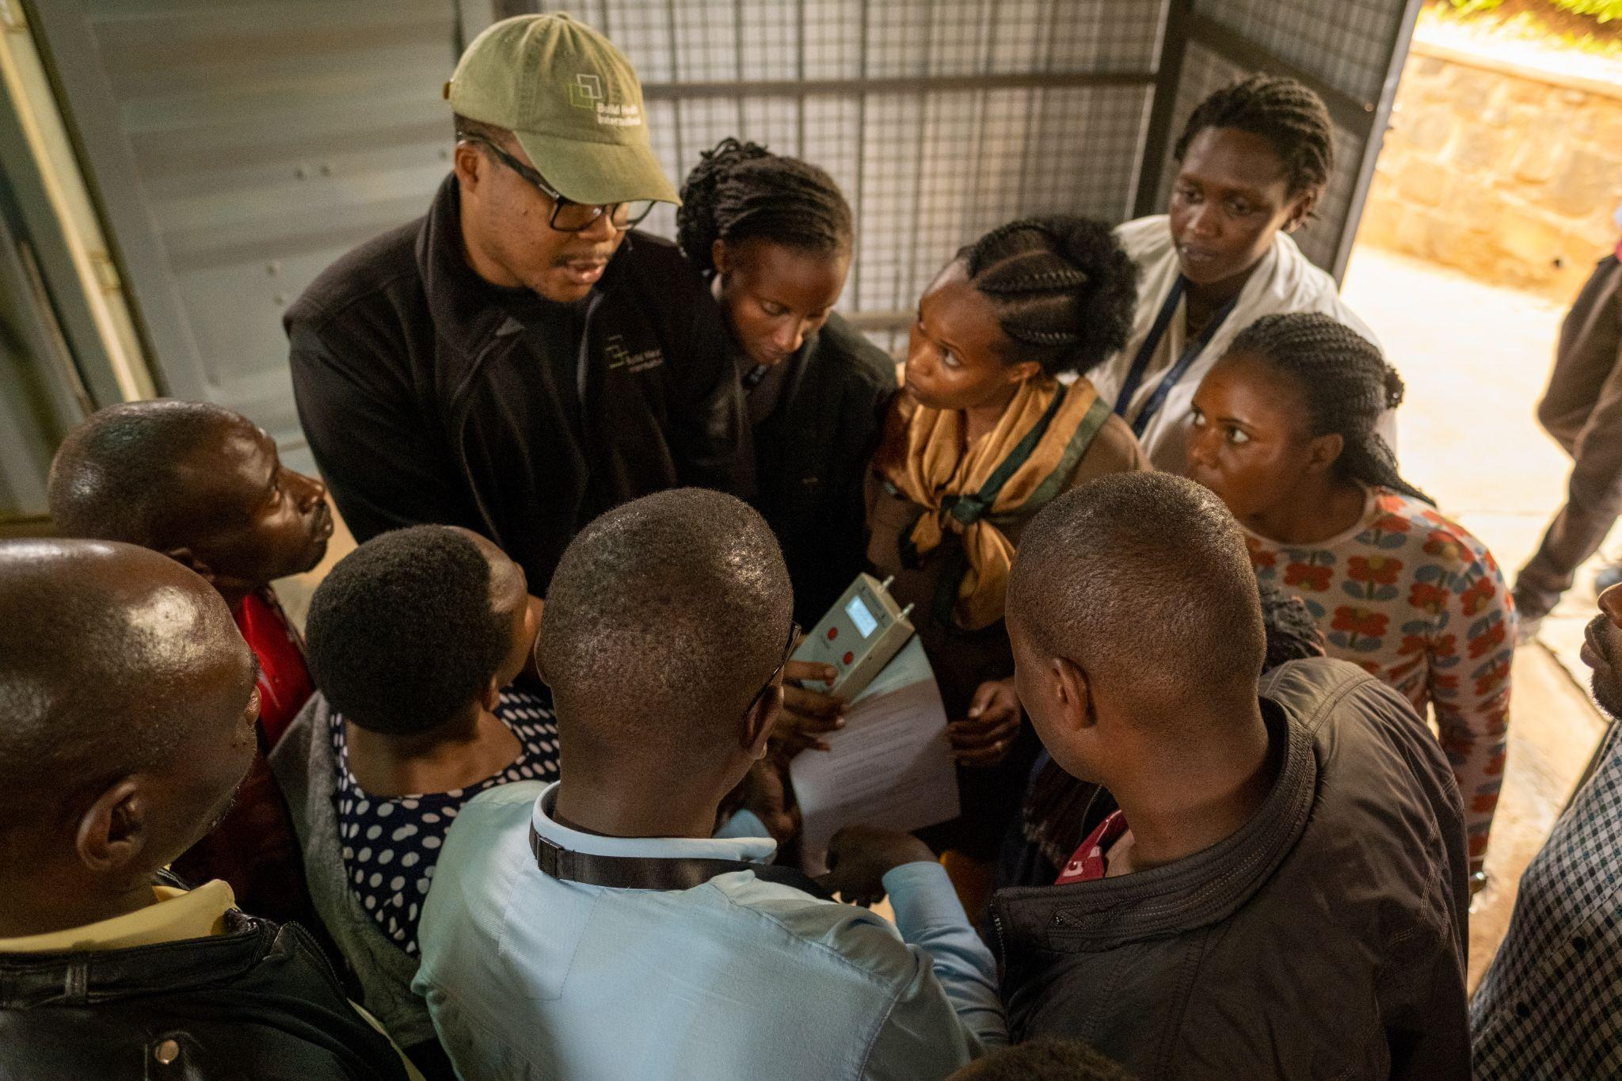
Project BOXER Training and Supplier Training
During the installation of a new PSA plant, suppliers conduct a training for site staff. However the quality of these trainings can vary. An additional Project BOXER training reinforces key concepts and emphasizes important practices to maintain an efficient PSA plant. The Project BOXER training consists of the following benefits:
More Comprehensive: Length of training 5 days instead of 1-3 days
Technical Detail: Increased level of depth and detail, pulling from BHI’s observations from our work in over 25 countries
Neutral: Brand-neutral and impartial
Safety: Strong emphasis on medical oxygen safety and risk mitigation
Long-term Sustainability: Focused on capacity building for sustainability
Experience and Lessons Learned: Share lessons learned from accidents and repairs
Post-training Support: Ongoing engagement through virtual support and community of practice
Sierra Leone: Kevin Ndeti presents management training slides
Rwanda: David Acolatse demonstrates using an oxygen analyzer

Slide 7
Project BOXER Oxygen Training Programs
 | Level of Expected PSA Knowledge | Length | Target Audience | Recommended Timing | Training Objective
Management Training | No Prior Knowledge | 2 Days | MoH leadership, Hospital Directors and Senior Management | Prior to installation or commissioning | Ensure that senior management is fully briefed on the function and operating requirements of PSA plants including maintenance and safety. Health sector leadership is prepared to successfully integrate new PSA plants and oxygen delivery equipment into health systems.
Maintenance Training | Beginner | 5 Days | Biomedical Engineers & Technicians, Facilities Managers, Hospital Operations Staff | Immediately after installation or commissioning | To prepare biomedical engineers, technicians, facilities managers, and plant operators to safely and sustainably operate and maintain PSA plants by providing the knowledge and building the skills necessary to: implement daily and ongoing preventive maintenance, perform daily maintenance check, and troubleshoot and conduct routine repairs.
Advanced Training | Intermediate | 5 Days | Experienced Engineers or Technicians with Supervisory or Training Roles | After commissioning, once master trainer candidates have been identified | To equip advanced technicians to train others on PSA plants and to conduct complex maintenance and repairs independently. An advanced version of the maintenance training that prepares experienced engineers and technicians to conduct more sophisticated maintenance, troubleshooting, and repair of PSA plants.
Notes:
*dependent on audience numbers.
Column of MAX REC Audience 40 man 30 main 15 TOT, depends on format/needs

Slide 8

Management Training
Two Day Training
No Experience Required
Objective: To ensure that senior management is fully briefed on the function and operating requirements of PSA plants including maintenance and safety. Health sector leadership is prepared to successfully integrate new PSA plants and oxygen delivery equipment into health systems.
Ministry of Health Senior Leadership
Hospital Directors and Senior Management

Slide 9
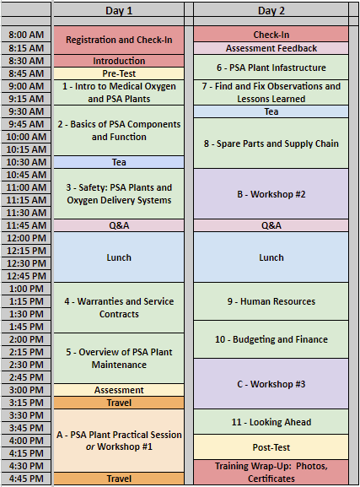
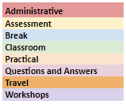
Management Training - Approach
Classroom sessions to build conceptual understanding of PSA plants and oxygen delivery systems
Briefing on budgeting, human resources, supply chain, warranty, service contracts
Site visit to PSA plant for practical, hands-on learning
Videos and case studies to raise awareness for medical oxygen safety and risk mitigation
Review of plant operator daily checklists to familiarize management with deliverables
Examples of circumstances that led to plant failures from BHI’s Find & Fix work
Discussion of spare parts and preventative maintenance
Interactive workshops to increase trainee participation and reinforce key concepts
Training Agenda

Slide 10

Management Training - Classroom Sessions
Topics Include:
Introduction to medical oxygen and PSA plants
Safety and hazard mitigation
Overview of PSA components and function
Find and Fix observations and Lessons Learned
Operating requirements for PSA Plants
Overview of PSA plant maintenance
Human Resources including staffing requirements and capacity building for PSA Plant Maintenance
Budgeting for PSA operations, oxygen delivery, and maintenance
Looking ahead - PSA plant management for sustainable oxygen supply
Sierra Leone Senior Management Training: A health sector leader poses a question during the Budgeting for PSA Operations module.

Slide 11

Maintenance Training
Five Day Intensive Training
Beginner Level
Objective: To prepare biomedical engineers, technicians, facilities managers, and plant operators to safely and sustainably operate and maintain PSA plants by providing the knowledge and building the skills necessary to:
implement daily and ongoing preventive maintenance,
perform daily maintenance check, and
troubleshoot and conduct routine repairs.
Biomedical Engineers and Technicians
Facilities Managers
Hospital Operations Staff

Slide 12
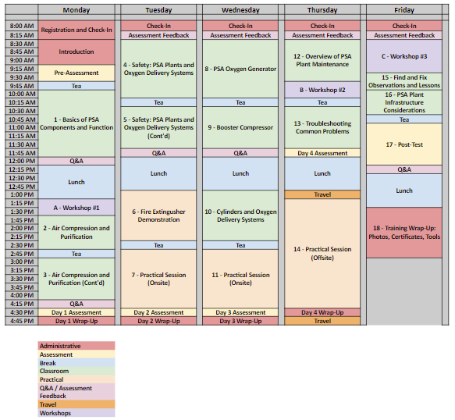
Maintenance Training - Approach
Training Agenda
Classroom sessions to provide a detailed, technical description of PSA plants and oxygen delivery systems
Site visits to PSA plants for practical, hands-on learning
Pre-training, daily, and post-training learning assessments
Adaptation of a BHI-designed daily checklist and preventative maintenance plan to specific PSA plants
Development of an online community of practice for ongoing technical support and engagement
Interactive workshops to increase trainee participation and reinforce key concepts
Notes:
Agenda own slide

Slide 13
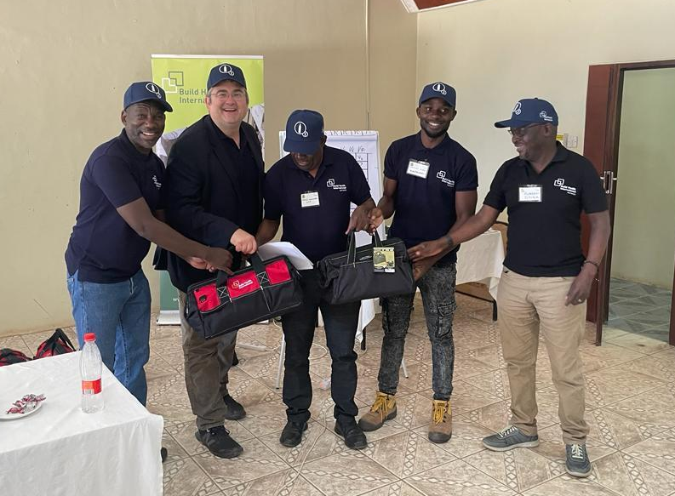
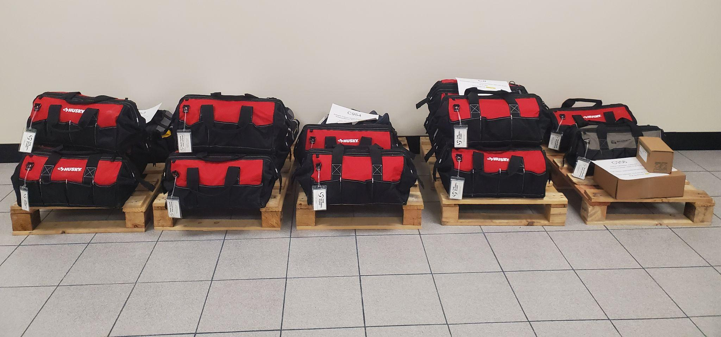
Maintenance Training - Tool Kits
Where tools cannot be sourced by the PR or are not provided by the supplier, BHI can assist with tool kit procurement.
PSA plant staff maintain and monitor very expensive, critical equipment for the hospital. Tool kits ensure they have what they need to be successful!
BHI’s Experience: Oftentimes technicians are not properly equipped, which prevents them from implementing the skills and best practices learned in training. Additionally, the tools they need can be difficult to source locally.
‹#›

Slide 14
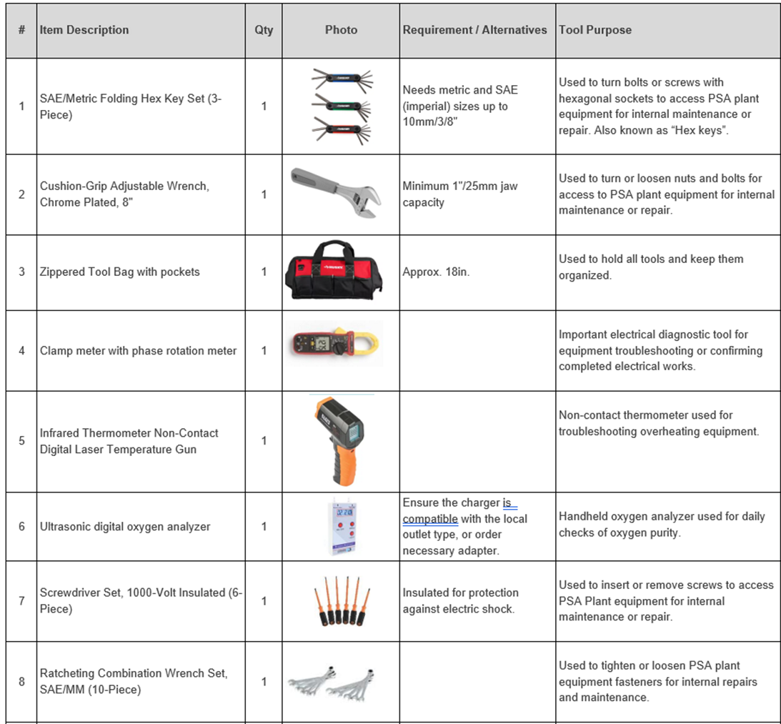
Maintenance Training - Tool Kits
General Tool Kit:
Essential tools required for PSA plant operators to effectively service their plant.
Booster Compressor Tool Kits:
A separate set of tools to be kept oxygen-safe for use in the service of the oxygen booster compressor.
Four booster kits are available:
Kit 1 – for RIX or ULTRACECO HP models
Kit 2 – for NOVAIR HP and Noxerior models
Kit 3 – for Bailian or ULTRACECO HPX models
Kit 4 – for Anshan Jiapeng models
‹#›

Slide 15
Maintenance Training - Highlights
Practical Sessions
Trainees have the opportunity to hone existing skills and apply concepts learned in classroom sessions, learn tips and techniques from instructors, and gain experience with PSA plant components that may not be present in their own plant.
Assessments
Participants will take daily assessments during the training, beginning with a pre-training assessment and ending with the post-training assessment. These are designed to help BHI instructors gauge learning, address any weak areas, and provide remediation during the training.
Materials
Trainees receive: electronic copy of training presentation, PSA daily maintenance checklist (52 weeks), preventative maintenance plan, PSA repair log, and PSA Plant tool kit.

Slide 16
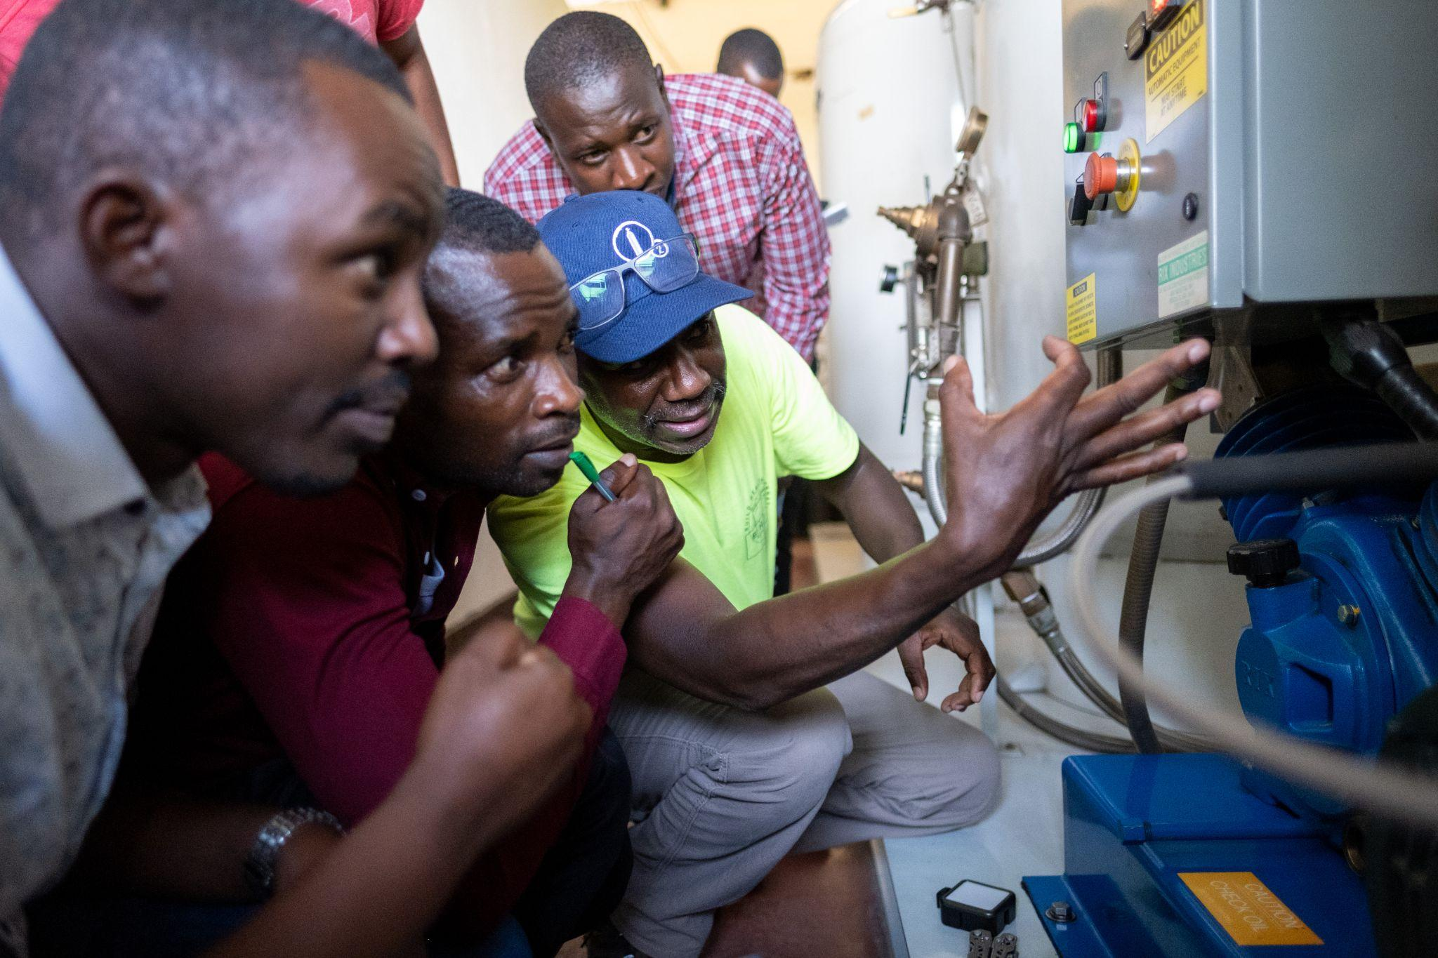
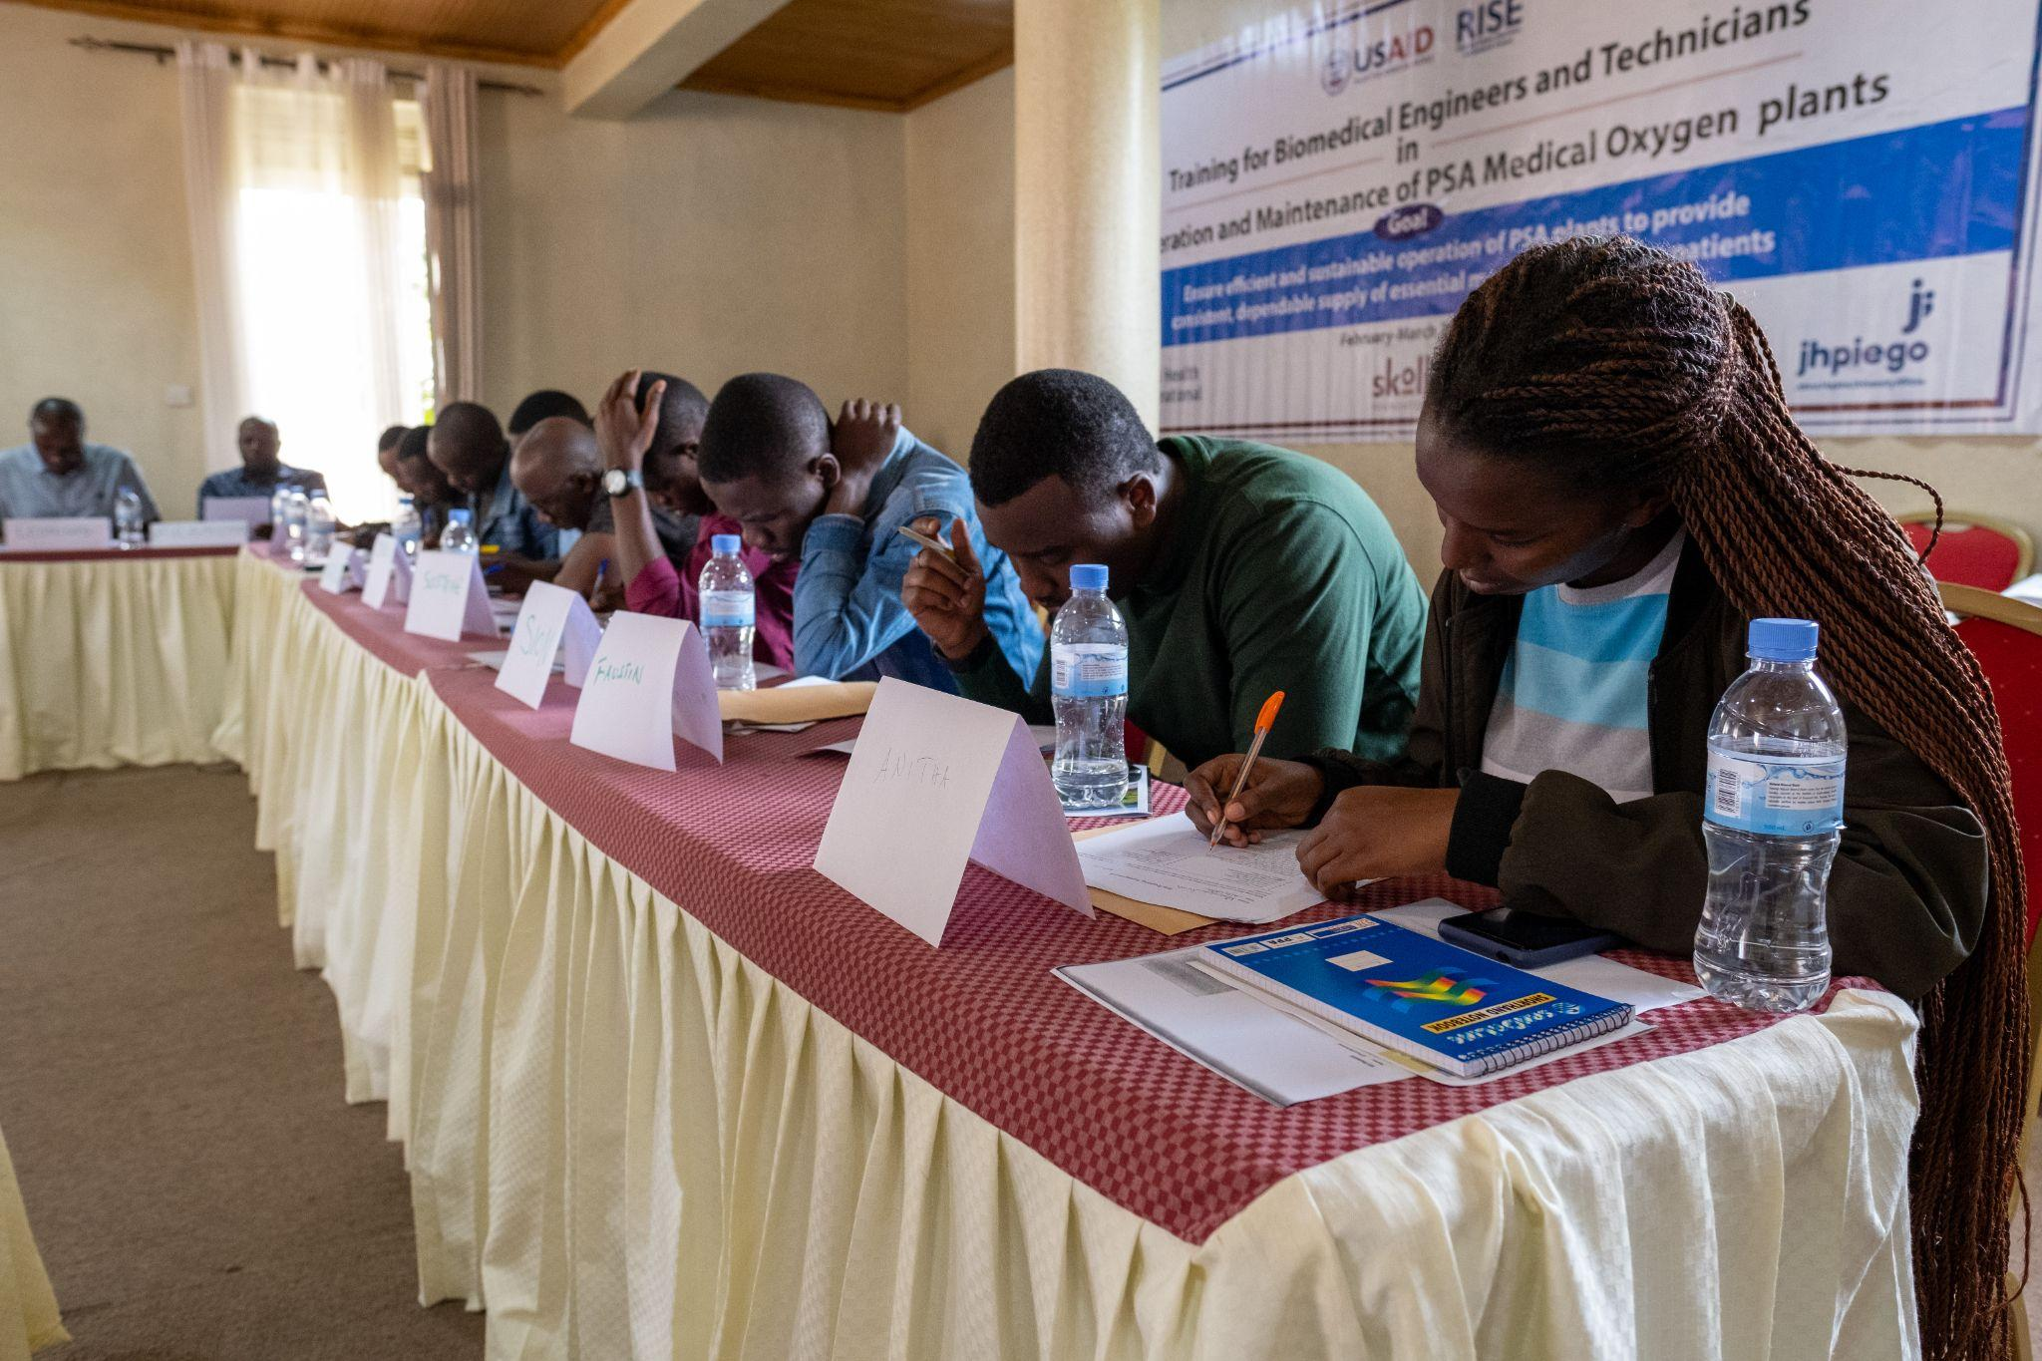
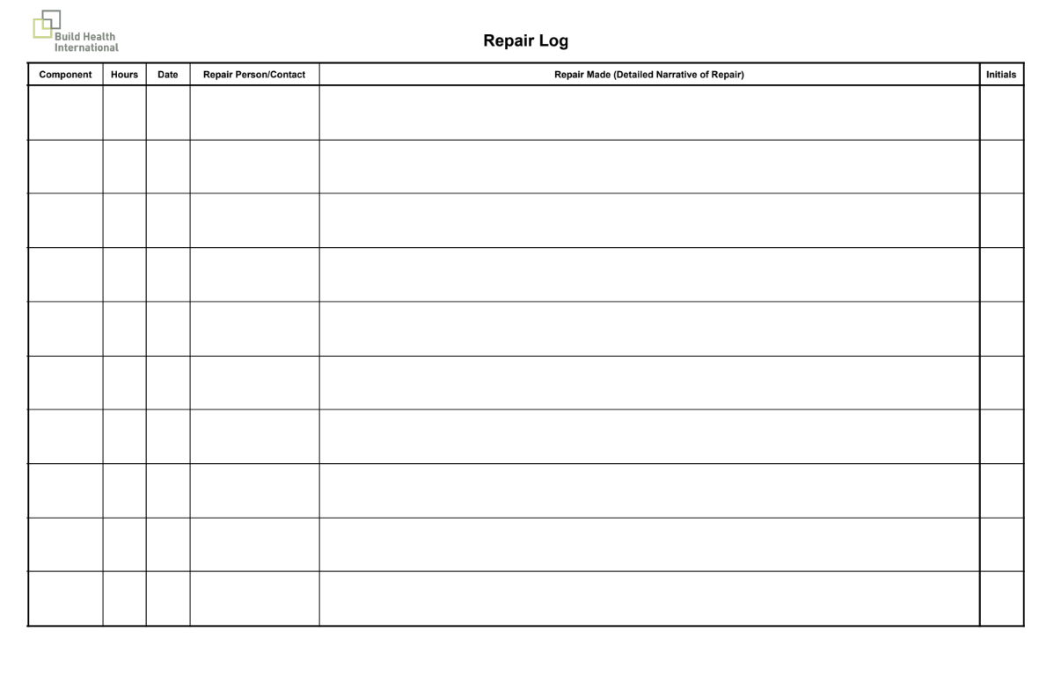
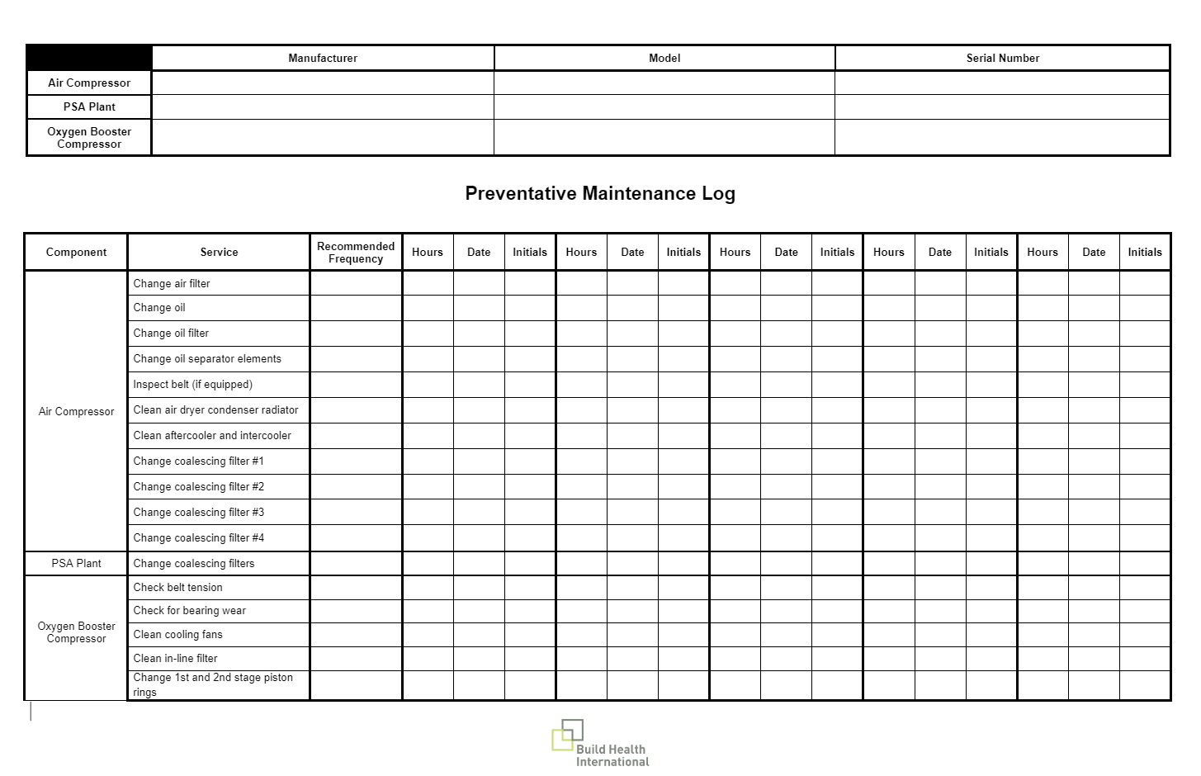
Maintenance Training Highlights
Rwanda: Steve Mtewa teaching about a component in the oxygen booster compressor
Rwanda: Trainees taking their daily assessment.

Slide 17
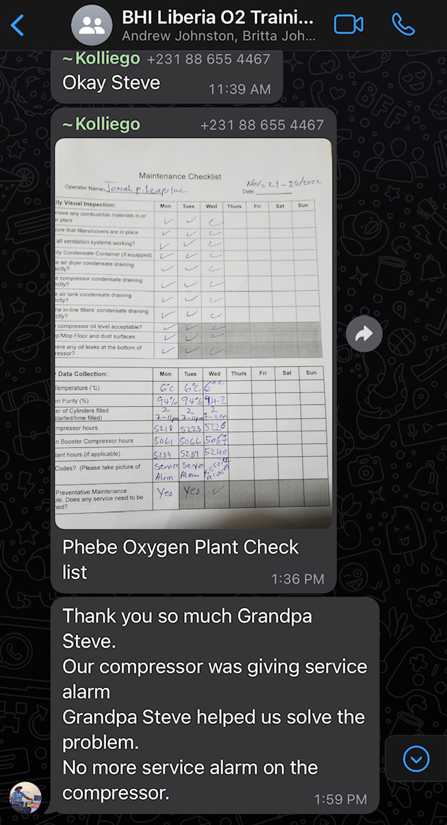
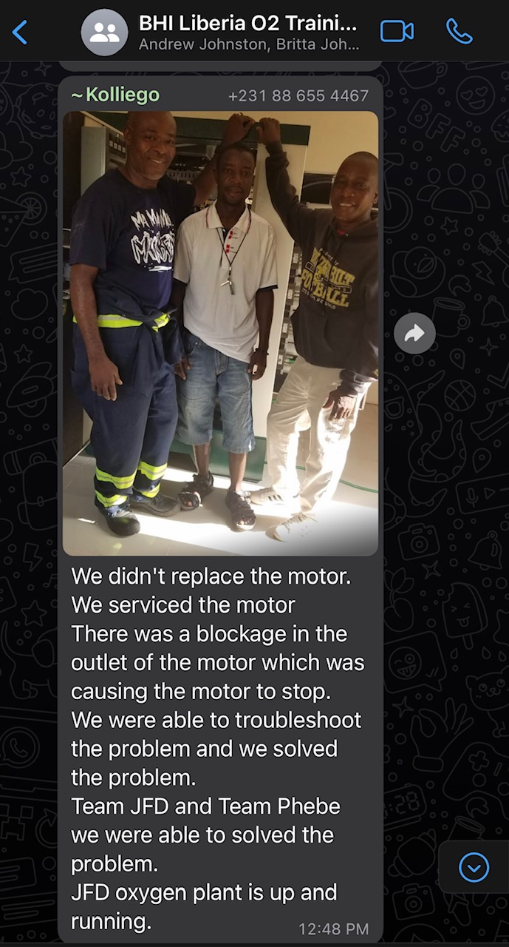
Ongoing Virtual Support
Ongoing Support: Each training cohort is invited to joining a country-specific WhatsApp community of practice where trainees can:
Ask Project BOXER technical assistance team and other trainees for troubleshooting advice and crowdsource ideas.
Keep each other accountable to stay up to date by sharing daily checklists, preventative maintenance logs, and repair logs.
Stay in touch with other biomedical engineers, technicians, and managers.
Stay connected for additional Project BOXER resource releases.
Liberia: The Liberian Biomedical Engineer/Technician virtual support group. Left: Phebe Oxygen Plant thanking BHI’s Steve “Grandpa” Mtewa for his assistance. Right: Operators from JFD Oxygen teamed up with Phebe Oxygen Plant and were able to assist one another in troubleshooting and solving a motor issue at JFD.
Notes:
Online community of practice
On whatsapp right now, but we’re in the process of developing a more official forum
Establishes connectivity especially for more

Slide 18

Advanced Training
Five Day Intensive Training
Intermediate/Advanced Level
Objective: To equip advanced technicians to train others on PSA plants and to conduct complex maintenance and repairs independently. An advanced version of the maintenance training that prepares experienced engineers and technicians to conduct more sophisticated maintenance, troubleshooting, and repair of PSA plants.
Experienced engineers and technicians with supervisory or training roles

Slide 19
Training of Trainers (Advanced Training) - Approach
Customized agenda based on needs. Agenda can focus on training of trainers (TOT) or on advanced training on PSA plant maintenance and repair.
TOT classroom sessions to prepare trainers to provide technical training on PSA plants and oxygen delivery systems
Advanced practical training in PSA plant maintenance and repair with a focus on complex components such as the air compressor or the booster compressor
Site visits to PSA plants for practical, hands-on learning
Trainees take an increased role in the training by delivering supervised practical and theoretical lessons.
Theoretical and practical pre-training, daily, and post-training learning assessments
Development of an online community of practice for ongoing technical support and engagement
Support developing a training curriculum and conducting onsite training, if applicable

Slide 20
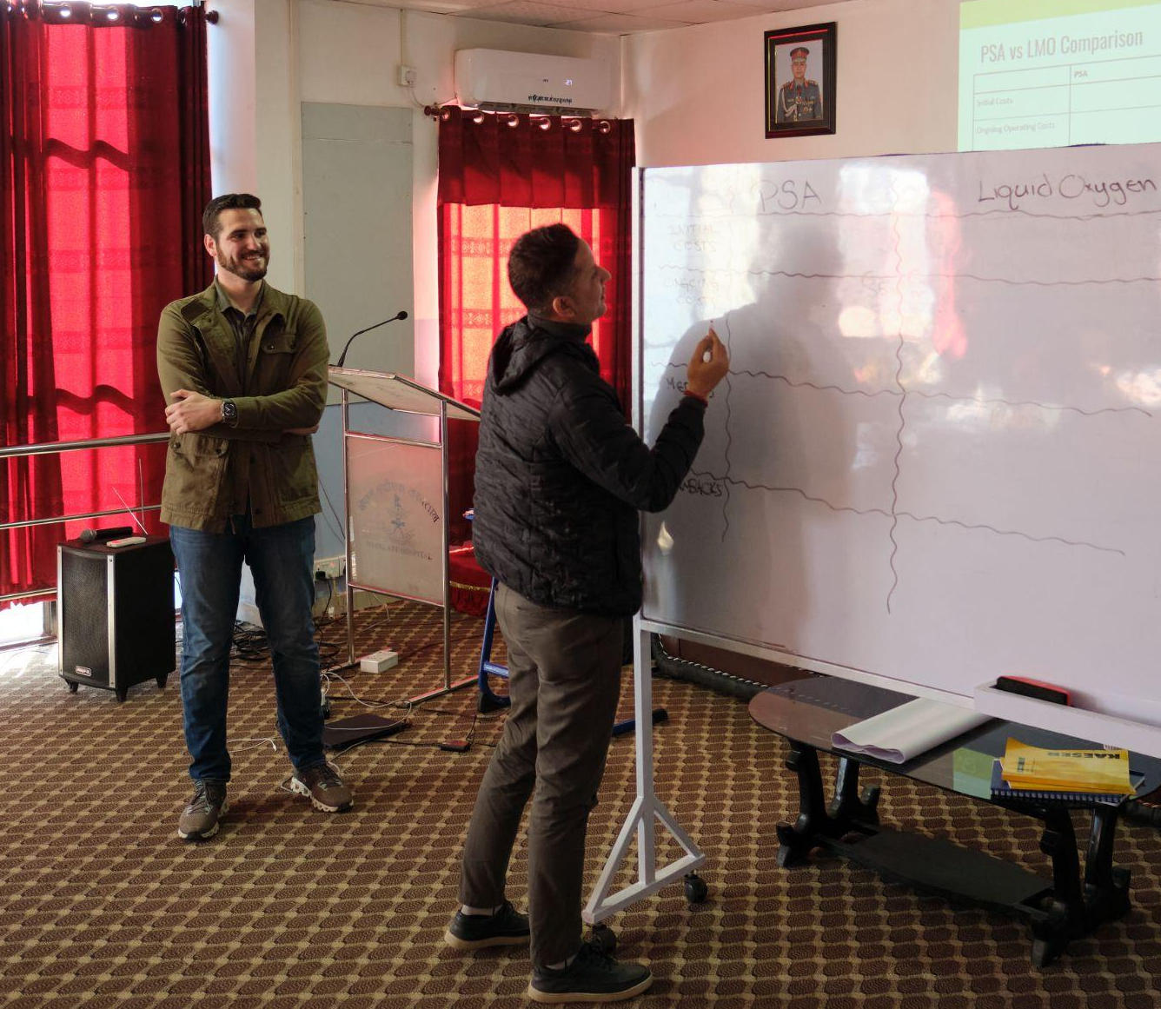
Training of Trainers - Classroom Sessions
Topics include:
Introduction to medical oxygen and PSA plants
Overview of PSA components and function
Safety and hazard mitigation
Air compression and purification
PSA oxygen generator
Oxygen booster pump
Principles of PSA plant operation
Oxygen delivery systems
Find and Fix observations and lessons learned
PSA plant maintenance checklists and planning
Nepal: Pedro Castro and advanced training candidate comparing PSA and liquid oxygen plants

Slide 21
Additional Training Opportunities
If appropriate during the procurement, installation, and/or commissioning process, BHI can provide training on the following subjects:
Site Assessment Training
Electrical Assessment (Future PSA Plant) Training
Repair Assessment Training
Electrical Assessment (Existing PSA Plant) Training
Quality Assurance Assessment Training

Slide 22
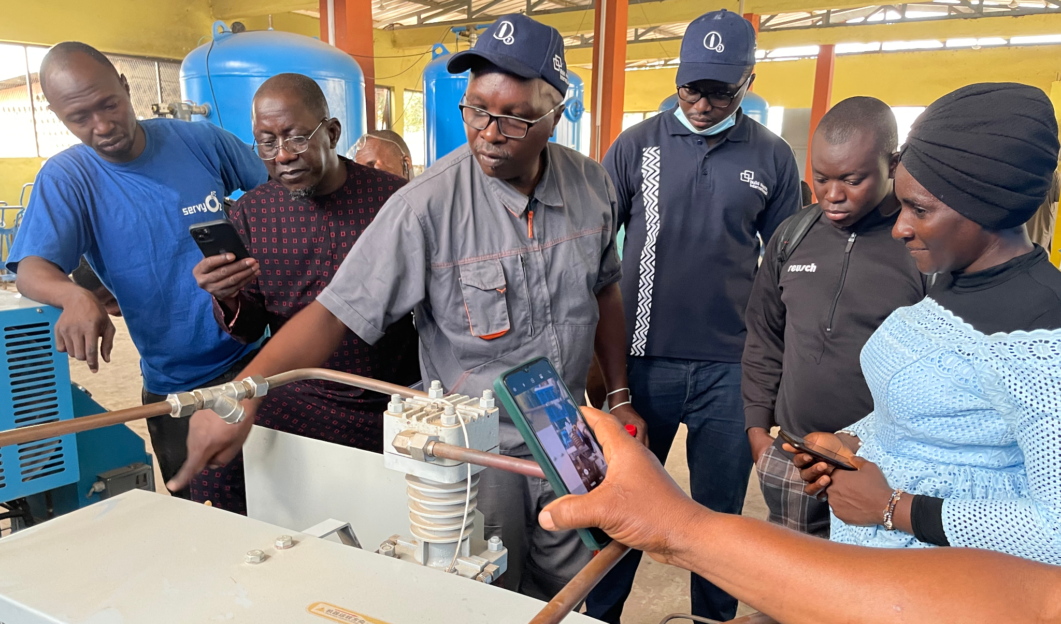
Project BOXER Training: Ongoing Support
Active post-training support is essential to helping trainees build skills and increase independence, as well as keeping PSA plants functioning. Ongoing support is a key contributor to PSA plant sustainability.
Monitoring and ongoing support through Project BOXER can include:
Review of completed Daily Maintenance Checklists and Preventative Maintenance Logs.
Virtual support from Project BOXER technical
assistance team.
Access to closed Whatsapp chat group or
other platform.
Community of practice (technicians
supporting other technicians).
Scheduled check in calls (individual or group).
Access to online content.
Refresher training.
Guinea: Jean Christian Ujeneza conducts hands on training in French at Donka Hospital in Conakry.
Notes:
On-site support where we find and fix, but then also teach re: repairs and maintenance. Voc Ed students!

Slide 23
Project BOXER Training Process: Planning
PR submits a formal request for training by completing the Training Request Form.
BHI schedules a consultation within two days of receiving training request.
BHI and PR meet to discuss the specific training needs.
BHI holds coordination calls with PRs and, as needed, with other in-country stakeholders, to refine needs and strategy for the trainings.
Following the consultation, the BHI team handles the following logistics:
Developing Terms of Reference and strategy for the training.
Presenting training materials and provides hands-on training with the PSA plant.
Providing trainees with copies of training materials.
Awarding certificates to trainees at the completion of the training.
The Principal Recipient (PR) is responsible for remaining logistics, including (but not limited to):
Identifying a venue for the training.
Sending invitations to trainees and confirms attendance prior to training.
Arranging lodging and transportation for trainees, if required.
Arranging per diems and transport payments for trainees.
Providing refreshments during training.

Slide 24
Project BOXER Training Process: Financials
The following training costs are covered by the Global Fund through Project BOXER:
BHI’s costs (staff time, flights, accommodations, etc.)
Training materials (printing hard copies, flash drives for digital copies, etc.)
Training certificates
Visibility and communications items (i.e. banners, signage, t-shirts, hats)
PSA plant tool kits for maintenance trainings (one tool kit per hospital represented)
Booster compressor tool kits for maintenance trainings (one tool kit per hospital represented, as needed)
The PR is responsible for the in-country training costs including:
Venue
Trainee lodging and meals
Transportation (to the venue, to the PSA plant, etc.)
Trainee per diems
Translators and associated services (if needed)
Any additional miscellaneous costs associated with the in-country training

Slide 25
Project BOXER Training Process: Timeline
Training Consultation
Training Planning and In-Country Logistics
Project BOXER On-Site Training
Post-Training Survey
Post-Training Support
Project BOXER team and PR meet to determine unique needs.
With introductions from PR, Project BOXER team engages with other oxygen partners in-country.
Project BOXER team prepares strategy and Terms of Reference.
PR arranges venue, identifies and invites trainees.
Management, maintenance, and/or advanced in-country training takes place.
Project BOXER team requests feedback from trainees.
Project BOXER provides virtual coaching, follow-up, and ongoing support.
4-6 weeks
Time from consultation to Project BOXER on-site training will depend on how quickly arrangements can be made in-country and the availability of the Project BOXER trainers.

